Slide 1

DEPARTMENT OF CSE
Course name - NETWORK PROTOCOLS & SECURITY
Course Code - 23EC2210R/A/E
Topic:
Data Link Layer: DLL design issues. Framing
Session - 07

Slide 2
AIM OF THE SESSION
To familiarize students with the basic concept of Data link layer and its design issues
INSTRUCTIONAL OBJECTIVES
LEARNING OUTCOMES
At the end of this session, you should be able to:
Describe the concepts of DLL
Describe the design issues of the DLL
Framing techniques in DLL
This Session is designed to:
Introduction to DLL and design issues.
Framing in DLL design issues with diagram

Slide 3
AGENDA
Data Link Layer Introduction
Data Link Layer: DESIGN ISSUES
Services Provided to Network Layer
Framing Implementations
Purpose of Data Link Layer
Summary
Self-Assessment Questions
Terminal questions
References

Slide 4
DLL Introduction
Elementary data link protocols: simplex protocol, A simplex stop and wait protocol for an error-free channel, A simplex stop and wait protocol for noisy channel.
Sliding Window protocols: A one-bit sliding window protocol, A protocol using Go-Back-N, A protocol using Selective Repeat, Example data link protocols.
Medium Access sub layer: The channel allocation problem, Multiple access protocols: ALOHA, Carrier sense multiple access protocols, collision free protocols. Wireless LANs, Data link layer switching.

Slide 5
DATA LINK LAYER: DESIGN ISSUES
The data link layer uses the services of the physical layer to send and receive bits over communication channels. It has a number of functions, including:
Providing a well-defined service interface to the network layer.
Dealing with transmission errors.
Regulating the flow of data so that slow receivers are not swamped by fast senders.
To accomplish these goals, the data link layer takes the packets it gets from the network layer and encapsulates them into frames for transmission.

Slide 6
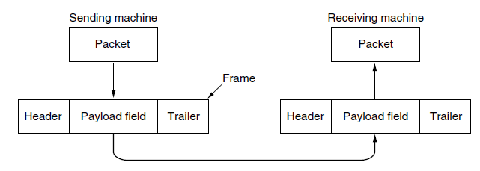
DATA LINK LAYER DESIGN ISSUES
Each frame contains a frame header, a payload field for holding the packet, and a frame trailer.
Frame management forms the heart of what the data link layer does. In the following sections we will examine all the above mentioned issues in detail.
Relationship between packets and frames

Slide 7
DESIGN ISSUES
Services Provided to Network Layer
Framing
Error control and Flow Control
Physical Layer Coding violations

Slide 8
Services Provided to the Network Layer
The function of the data link layer is to provide services to the network layer.
The principal service is transferring data from the network layer on the source machine to the network layer on the destination machine. On the source machine is an entity, call it a process, in the network layer that hands some bits to the data link layer for transmission to the destination.
The job of the data link layer is to transmit the bits to the destination machine so they can be handed over to the network layer there, as shown in Fig. 3-2(a). The actual transmission follows the path of Fig. 3-2(b), but it is easier to think in terms of two data link layer processes communicating using a data link protocol. For this reason, we will implicitly use the model of Fig. 3-2(a) throughout this chapter.

Slide 9
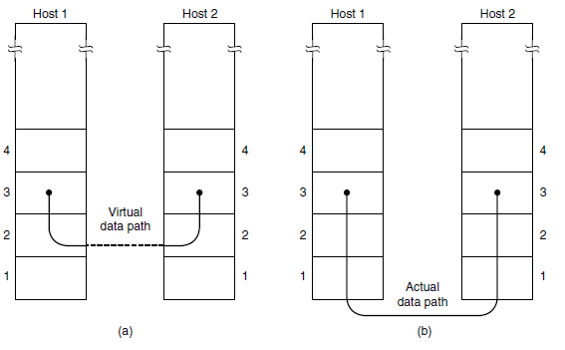
Services Provided to the Network Layer
(a) Virtual communication. (b) Actual communication.

Slide 10
Services Provided to the Network Layer
The data link layer can be designed to offer various services. The actual services that are offered vary from protocol to protocol. Three reasonable possibilities that we will consider in turn are:
1. Unacknowledged connectionless service.
2. Acknowledged connectionless service.
3. Acknowledged connection-oriented service.
Unacknowledged connectionless service consists of having the source machine send independent frames to the destination machine without having the destination machine acknowledge them.

Slide 11
Services Provided to the Network Layer
Acknowledged connectionless service is offered, there are still no logical connections used, but each frame sent is individually acknowledged. In this way, the sender knows whether a frame has arrived correctly or been lost. If it has not arrived within a specified time interval, it can be sent again.
This service is useful over unreliable channels, such as wireless systems. 802.11 (WiFi) is a good example of this class of service.

Slide 12
Services Provided to the Network Layer
Acknowledged connection-oriented service is used, transfers go through three distinct phases.
In the first phase, the connection is established by having both sides initialize variables and counters needed to keep track of which frames have been received and which ones have not.
In the second phase, one or more frames are actually transmitted.
In the third and final phase, the connection is released, freeing up the variables, buffers, and other resources used to maintain the connection.

Slide 13
FRAMING
To provide service to the network layer, the data link layer must use the service provided to it by the physical layer. What the physical layer does is accept a raw bit stream and attempt to deliver it to the destination.
If the channel is noisy, as it is for most wireless and some wired links, the physical layer will add some redundancy to its signals to reduce the bit error rate to a tolerable level.
However, the bit stream received by the data link layer is not guaranteed to be error free. Some bits may have different values and the number of bits received may be less than, equal to, or more than the number of bits transmitted. It is up to the data link layer to detect and, if necessary, correct errors.
The usual approach is for the data link layer to break up the bit stream into discrete frames, compute a short token called a checksum for each frame, and include the checksum in the frame when it is transmitted.

Slide 14
Framing implemented by
Character count
Flag Byte with byte stuffing
Starting and ending flags with bit stuffing
Physical layer Coding violation

Slide 15
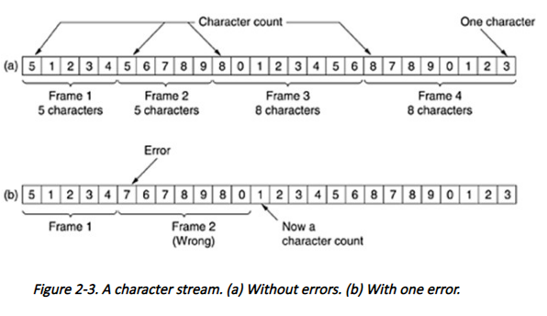
Framing using Character count

Slide 16
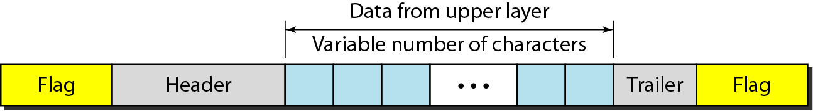
A frame in a character-oriented protocol

Slide 17
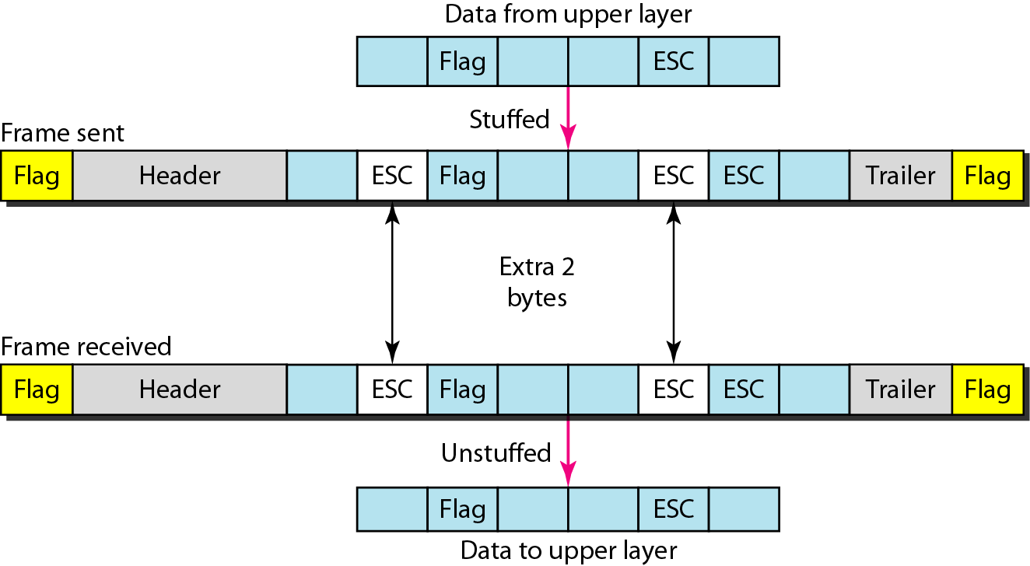
Byte stuffing and unstuffing

Slide 18
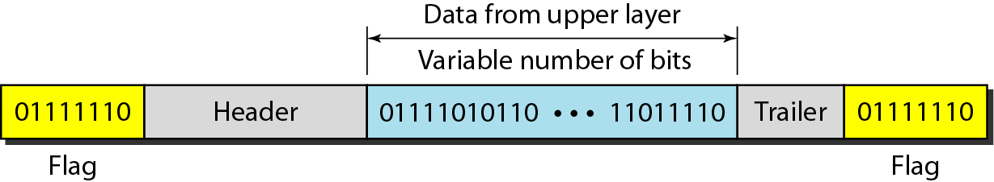
A frame in a bit-oriented protocol

Slide 19
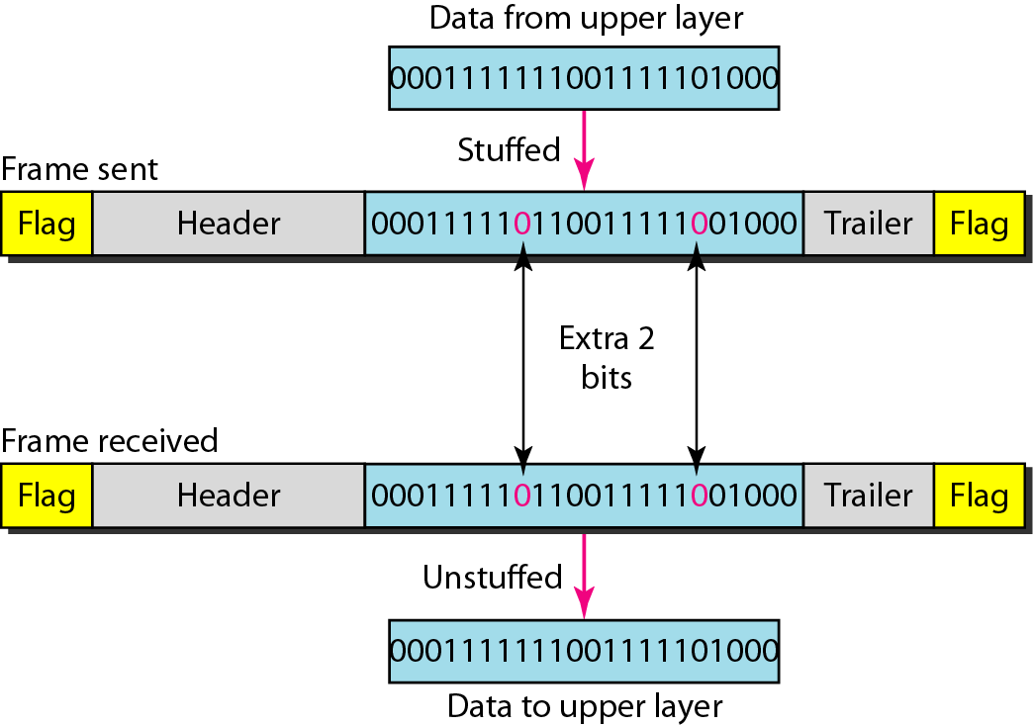
Bit stuffing and unstuffing

Slide 20
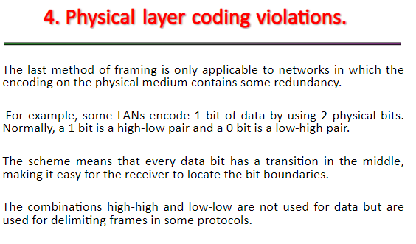

Slide 21
Purpose of Data Link Layer
The purpose of the data link layer is to provide reliable and error-free communication between two directly connected network nodes. It is the second layer of the OSI (Open Systems Interconnection) model and resides above the physical layer.

Slide 22
SUMMARY
Data link layer and various design issues
Framing techniques

Slide 23
SELF-ASSESSMENT QUESTIONS
An upper-layer packet is split into 10 frames, each of which has an 80% chance of arriving undamaged. If no error control is done by the data link protocol, how many times must the message be sent on average to get the entire thing through?
The primary purpose of the data link layer in a network architecture is to provide reliable and error-free communication between two directly connected network nodes. It acts as an intermediary between the network layer above and the physical layer below.
A bit string, 0111101111101111110, needs to be transmitted at the data link layer. What is the string actually transmitted after bit stuffing?
The framing process in the data link layer involves breaking up the data received from the network layer into manageable units called frames. The frames are then transmitted over the physical medium to the receiving node.
Which of the following is NOT a design issue in the data link layer?
a) Framing b) Error detection and correction c) Congestion control d) Flow control
Which design issue in the data link layer is responsible for managing access to a shared transmission medium?
a) Error control b) Flow control c) Medium access control d) Congestion control

Slide 24
TERMINAL QUESTIONS
What is the difference between the data link layer and the physical layer?
What are the two sublayers of the data link layer?
What is the purpose of the LLC sublayer?
What is the purpose of the MAC sublayer?
What are some common protocols used in the data link layer?
How does the data link layer handle error detection?
What is flow control in the data link layer?

Slide 25
REFERENCES FOR FURTHER LEARNING OF THE SESSION
Text Books
1 | Data Communications and Networking (3rd Ed.) “–B. A. Ferouzan – TMH
2 | Computer Networks (4th Ed.)”, A. S. Tanenbaum – – Pearson Education/PHI
Reference Text books
1 | Data and Computer Communications (5th Ed.)” – W. Stallings – PHI/ Pearson Education
2 | Network for Computer Scientists & Engineers, Zheng & Akhtar, OUP
3 | Data & Computer Communication, Black, PHI
4 | Data Communication & Network, Miller, Vikas
5 | Digital & Data Communication, Miller, Jaico
6 | Understanding Data Communication & Network, Shay Vikas
Web References
1 | Kurose and Rose – “Computer Networking -A top down approach featuring the internet”– Pearson Education
2 | “Communication Networks” – Leon, Garica, Widjaja TMH
3 | “Internetworking with TCP/IP, Comer – vol. 1, 2, 3(4th Ed.)” – Pearson Education/PHI
4 | https://www.tutorialspoint.com/what-is-closed-loop-congestion-control/
5 | https://www.geeksforgeeks.org/congestion-control-techniques-in-computer-networks/3.

Slide 26
THANK YOU

